Slide 1
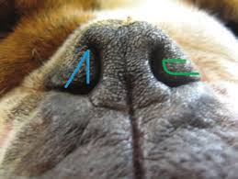
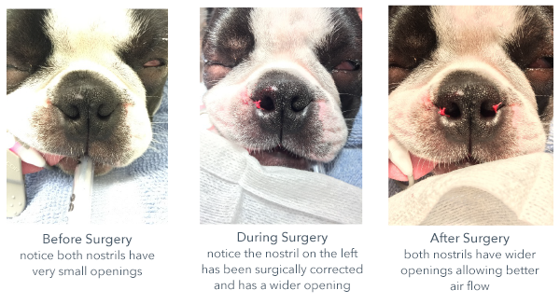
Stenotic Nares Resection (Rhinoplasty)
1-Grasp the margin of the nares with a Brown-Adson thumb forceps. While maintaining this grip, make a V-shaped incision around the forceps with a No. 11 scalpel blade.
2-Make the first incision medially and the second incision laterally. Remove the vertical wedge of tissue.
2-Control hemorrhage with digital pressure and by reapposing the cut edges.
3-Align the ventral margin of the nares and the mucocutaneous junction, and place three or four simple interrupted sutures using synthetic absorbable material (3-0 or 4-0 poliglecaprone 25 glycomer, polyglactin 910 [Vicryl]) to reappose the tissues.
4-Repeat the procedure on the opposite side, taking care to excise a tissue wedge of the same size.

Slide 2
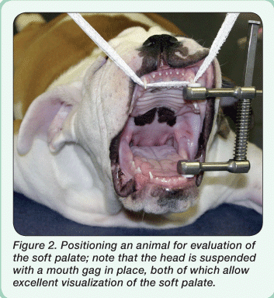
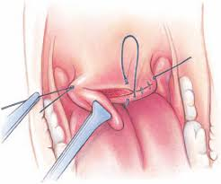
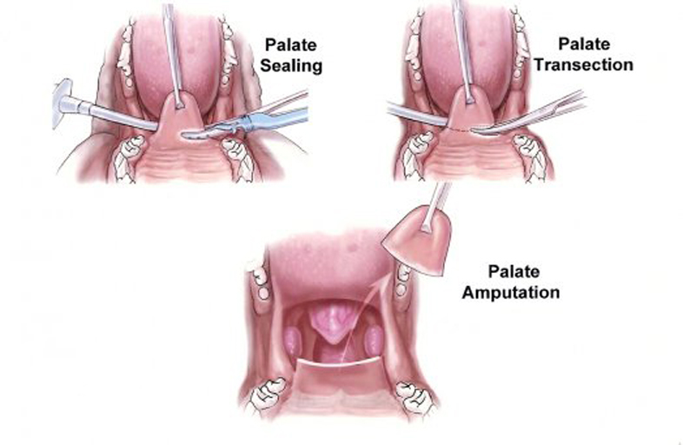
Elongated Soft Palate Resection (Staphylectomy)
1-Visually mark the site of proposed resection using the tip of the epiglottis and the caudal margin or the midpoint of the tonsils as landmarks.
2-Handle the soft palate gently and as little as possible to prevent excessive mucosal swelling.
3-Grasp the tip of the soft palate with thumb forceps or Allis tissue forceps, or place a stay suture. Place additional stay sutures at the proposed site of resection on the right and left borders of the palate. Place hemostats on these sutures and have an assistant apply lateral traction.
4-Transect across one-third to half of the width of the soft palate with curved
Metzenbaum scissors. Begin a simple continuous suture pattern (4-0 absorbable monofilament suture) at the borderof the palate, apposing the oropharyngeal and nasopharyngeal mucosa .
5-Continue transecting and suturing until the excess palate has been resected.

Slide 3
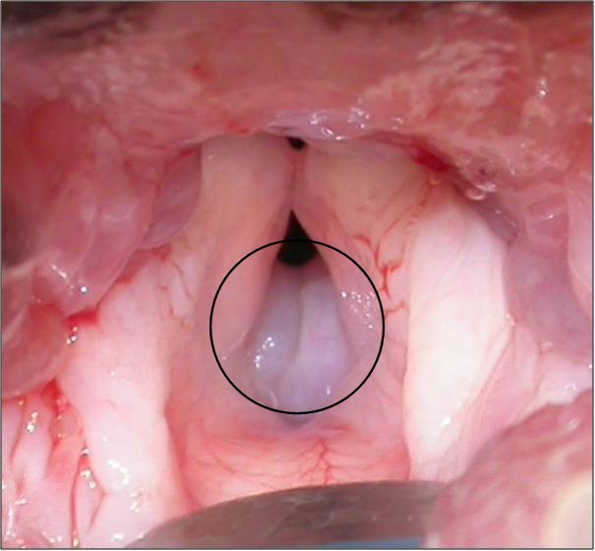
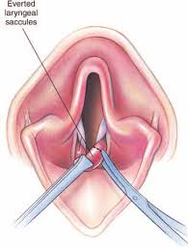
Everted Laryngeal Saccules
1-Retract the endotracheal tube dorsomedially so that the saccule on one side can be better visualized.
2-Grasp the everted saccule with long-handled forceps or a tissue hook. Position the tip of a long-handled, curved Metzenbaum scissors at the base of the everted tissue and transect . Biopsy forceps or laryngeal cup forceps may also be used.
3-Control hemorrhage with gentle pressure.
4-Repeat the procedure on the opposite side. Handle the tissues gently.

